Slide 1
Text Preprocessing with R
Data Science in context presentation
Data 607 Fall Term 2019
Ajay arora

Slide 2
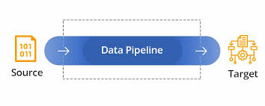
Purpose: Healthcare Fraud Detection
Text - Preprocessing

Slide 3
Agenda
Text Mining
Preprocessing: Term Frequency
5 Simple Steps to Create Term Frequency/Word Clouds in R

Slide 4
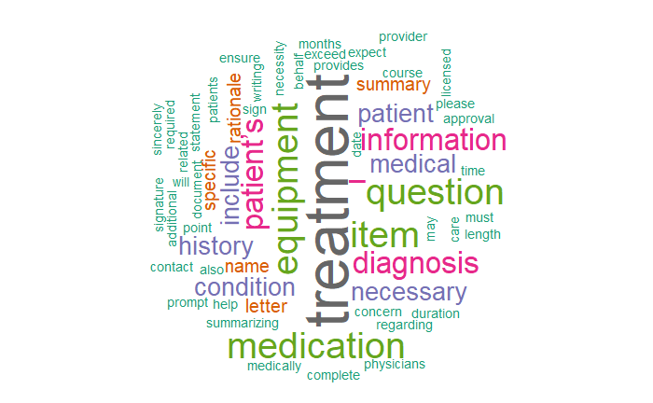
Text Mining: Term Frequency
methods allow us to highlight the most frequently used keywords in a paragraph of texts. One can create a word cloud, also referred as text cloud or tag cloud, which is a visual representation of text data.
 | word | freq
treatment | treatment | 9
equipment | equipment | 5
item | item | 5
medication | medication | 5
question | question | 5
diagnosis | diagnosis | 4
– | – | 4
information | information | 4
patient’s | patient’s | 4
medical | medical | 3

Slide 5
Preprocessing
Electronic Health Record (EHR) is a digital version of a patient’s paper chart. Our preprocessing steps “shred” these documents to create frequency counts of medical diagnosis and treatment.
Ten common health care provider fraud schemes
Billing for services not rendered.
Billing for a non-covered service as a covered service.
Misrepresenting dates of service.
Misrepresenting locations of service.
Misrepresenting provider of service.
Waiving of deductibles and/or co-payments.
Incorrect reporting of diagnoses or procedures (includes unbundling).
Overutilization of services.
Corruption (kickbacks and bribery).
False or unnecessary issuance of prescription drugs.

Slide 6
5 Simple Steps to Create Word Clouds in R
Term Frequency/ Word Cloud
Step 1: Source file
Step 2 : Install and load the required packages
Step 3 : Text mining
Step 4 : Build a term-document matrix
Step 5 : Generate the Word cloud

Slide 7
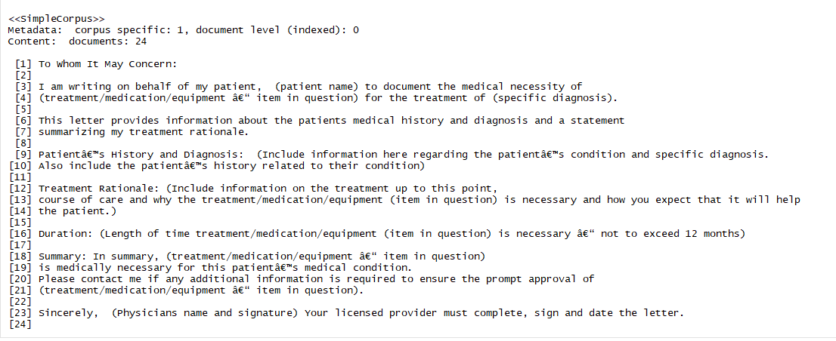
Step 1: Source file

Slide 8
Step 2 : Install and load the required packages
library("tm")
library("SnowballC")
library("wordcloud")
library("RColorBrewer")

Slide 9
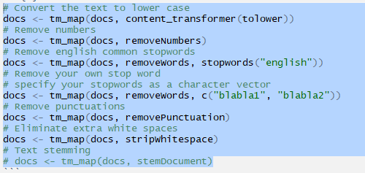
Step 3 : Text mining
# Load the data as a corpus
docs <- Corpus(VectorSource(text))
#Clean Text

Slide 10
Step 4 : Build a term-document matrix
dtm <- TermDocumentMatrix(docs)
m <- as.matrix(dtm)
v <- sort(rowSums(m),decreasing=TRUE)
d <- data.frame(word = names(v),freq=v)

Slide 11
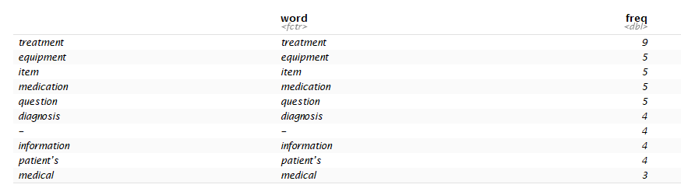
Step 5 : Generate the Word cloud

